Slide 1
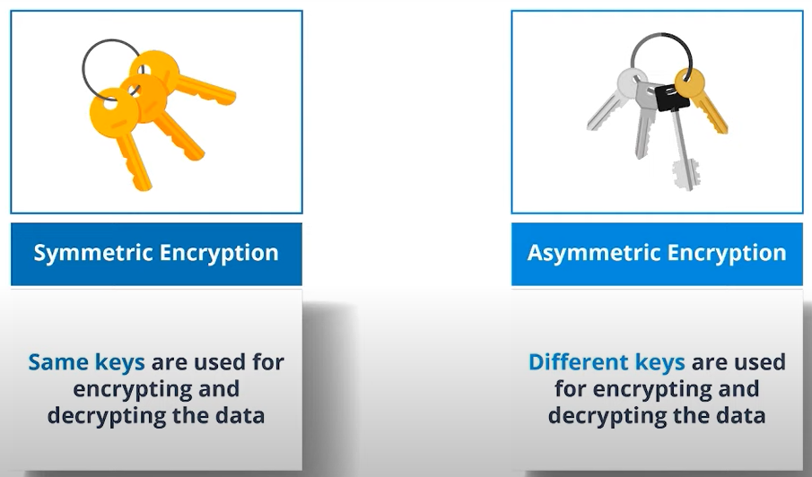
Types of Cryptosystems

Slide 2
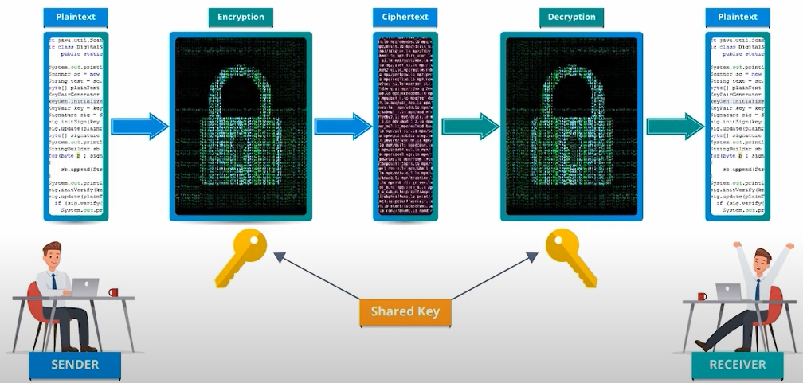
Symmetric Encryption (Private Key Cryptography/Secret Key Cryptography)

Slide 3
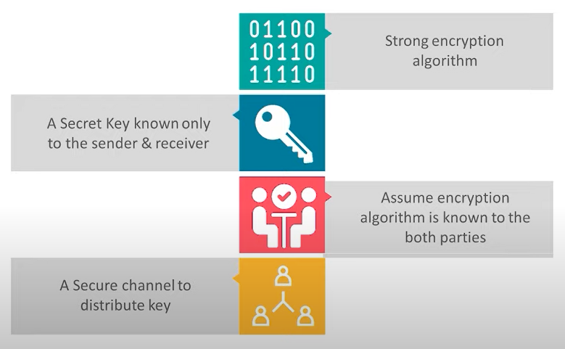
Requirements of Symmetric Encryption

Slide 4
Symmetric Encryption Algorithms
Block ciphers and Stream ciphers are two separate methods of encrypting data with symmetric encryption algorithms:
Encrypting information in chunks. A block cipher breaks down plaintext messages into fixed-size blocks before converting them into ciphertext using a key.
Encrypting information bit-by-bit. A stream cipher, on the other hand, breaks a plaintext message down into single bits, which then are converted individually into ciphertext using key bits.

Slide 5
Example
If you want a simple analogy to better understand a block cipher vs stream cipher, imagine you’re encrypting a book. You could encrypt the content one page at a time (block cipher) or one letter at a time (stream cipher).

Slide 6
What is Symmetric Encryption Used For?
While symmetric encryption is an older method of encryption, it is faster and more efficient than asymmetric encryption, which takes a toll on networks due to performance issues with data size and heavy CPU use.
Due to the better performance and faster speed of symmetric encryption (compared to asymmetric), symmetric cryptography is typically used for bulk encryption / encrypting large amounts of data, e.g. for database encryption.
Some examples of where symmetric cryptography is used are:
Payment applications, such as card transactions where PII needs to be protected to prevent identity theft or fraudulent charges
Validations to confirm that the sender of a message is who he claims to be
Random number generation or hashing

Slide 7
Some examples of symmetric encryption algorithms include:
AES (Advanced Encryption Standard)
DES (Data Encryption Standard)
IDEA (International Data Encryption Algorithm)
Blowfish (Drop-in replacement for DES or IDEA)
RC4 (Rivest Cipher 4)
RC5 (Rivest Cipher 5)
RC6 (Rivest Cipher 6)
AES, DES, IDEA, Blowfish, RC5 and RC6 are block ciphers. RC4 is stream cipher.

Slide 8
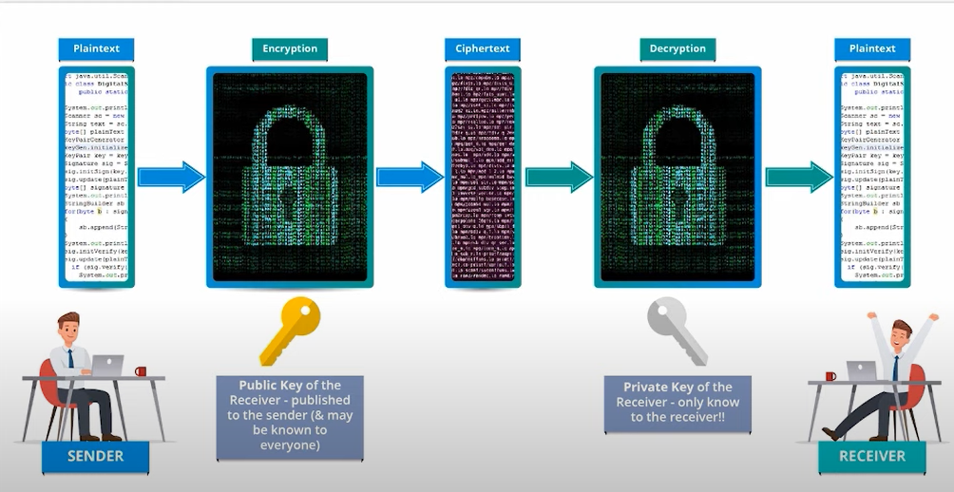
Asymmetric Encryption (Public Key Cryptography)

Slide 9
Benefits of public key cryptography
Every user in this system needs to have a pair of different keys(private and public key). They are mathematically related. Here one key is used for encryption and another key is used for decryption.
The public key is put in public repository and the private key is well guarded. Hence it is called public key cryptography.
Even though both the keys are related, it is not mathematically possible to find the key if the other key is known.
When the sender wants to send data to the receiver, he obtains the public key of the receiver from some repository published by the receiver, encrypts the data and transmits. The receiver then uses his private key to extract the plain text.

Slide 10
Length of keys(no. of bits) in this encryption is large and hence the process of encryption and decryption is slower when compared to symmetric key encryption.
Asymmetric algorithm needs more compute(processing) power as compared to symmetric key encryption.

Slide 11
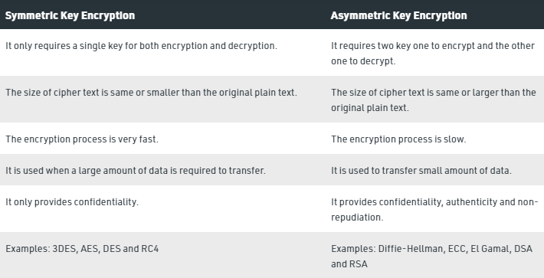

Slide 12
XOR operations in cryptography
This is an important concept to cover when talking about block and stream ciphers.
XOR Encryption is an encryption method used to encrypt data and is hard to crack by brute-force method, i.e generating random encryption keys to match with the correct one.
The basic idea behind XOR – encryption is, if you don’t know the XOR-encryption key before decrypting the encrypted data, it is impossible to decrypt the data.
For example, if you XOR two unknown variables you cannot tell what the output of those variables is. Consider the operation A XOR B, and this returns true.
Now if the value of one of the variable is known we can tell the value of another variable. If A is True then B should be False or if A is False then B should be true according to the properties of the boolean XOR operation.
Without knowing one of the value we can not decrypt the data and this idea is used in XOR – encryption.

Slide 13
Basics of cryptography
Bitwise XOR (^) operator will take two equal length binary sequence and perform bitwise XOR operation on each pair of bit sequence.
XOR operator will return 1, if both bits are different.
If bits are same, it will return 0.

Slide 14
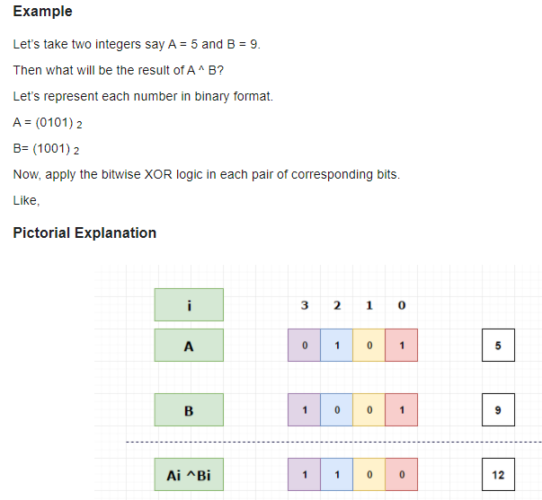

Slide 15
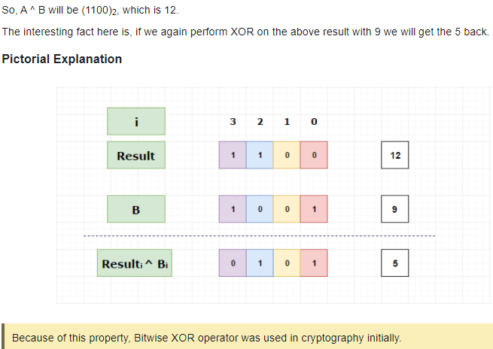

Slide 16
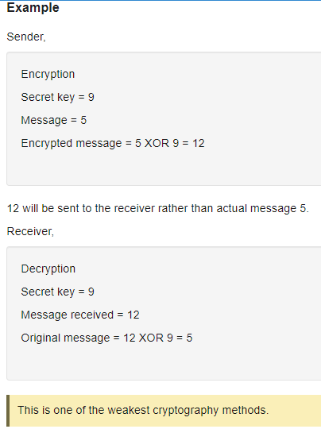

Slide 17
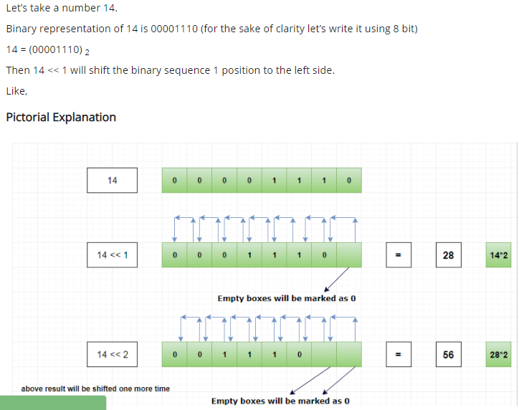
Bitwise Left shift << operator

Slide 18
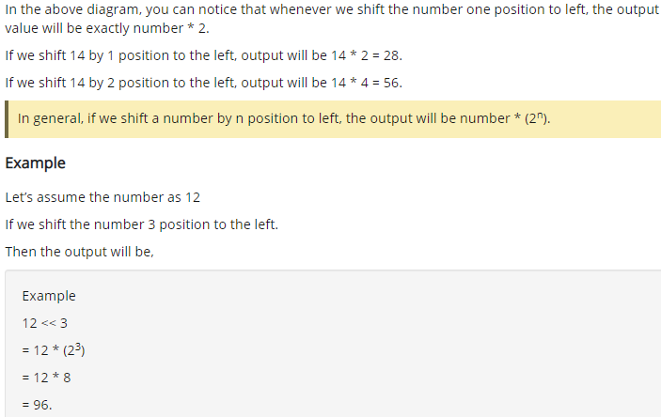

Slide 19
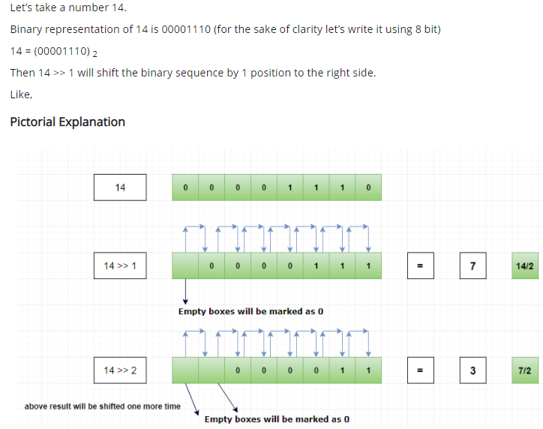
Bitwise Right shift >> operator

Slide 20
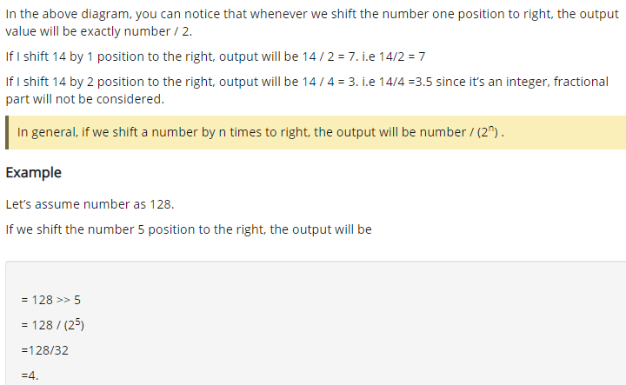

Slide 21
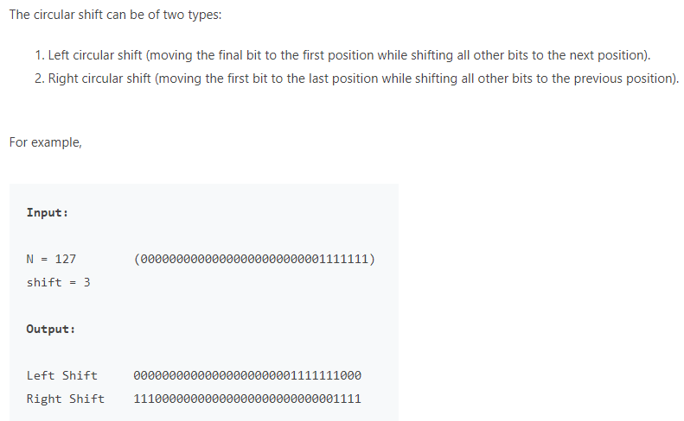
Circular shift

Slide 22
Block Cipher
A block cipher is a method of encrypting data in blocks to produce ciphertext using a cryptographic key and algorithm.
The block cipher processes fixed-size blocks simultaneously, as opposed to a stream cipher, which encrypts data one bit at a time.
Most modern block ciphers are designed to encrypt data in fixed-size blocks of either 64 or 128 bits.

Slide 23
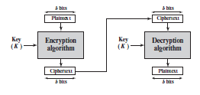
Block Cipher

Slide 24
Block Cipher Principles
A block cipher is designed by considering its three critical aspects:
Number of Rounds
Design of Function F
Key Schedule Algorithm

Slide 25
1.Number of Rounds
The number of rounds judges the strength of the block cipher algorithm. It is considered that more is the number of rounds, difficult is for cryptanalysis to break the algorithm.
It is considered that even if the function F is relatively weak, the number of rounds would make the algorithm tough to break.
2.Design of Function F
The function F of the block cipher must be designed such that it must be impossible for any cryptanalysis to unscramble the substitution. The criterion that strengthens the function F is it non-linearity.
The Function F should be designed such that it possesses a bit independence criterion which states that the output bits must change independently if there is any change in the input bit.
3. Key Schedule Algorithm
It is suggested that the key schedule should confirm the strict avalanche effect and bit independence criterion.

Slide 26
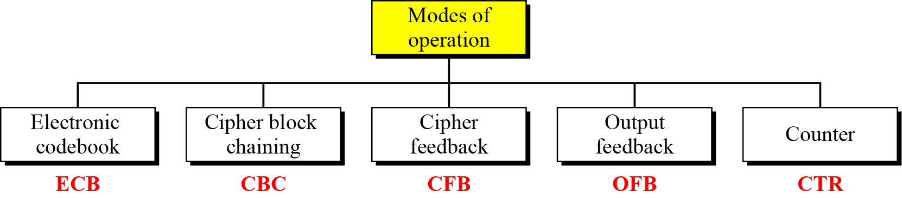
Modes of Operation
A mode of operation describes the process of encrypting each of these blocks under a single key.
Current well-known modes of operation:

Slide 27
Electronic Codebook Book (ECB)
Message is broken into independent blocks which are encrypted
Each block is a value which is substituted, like a codebook, hence name
Each block is encoded independently of the other blocks
C_{i} = E_{K} (P_{i})
Uses: secure transmission of single values

Slide 28
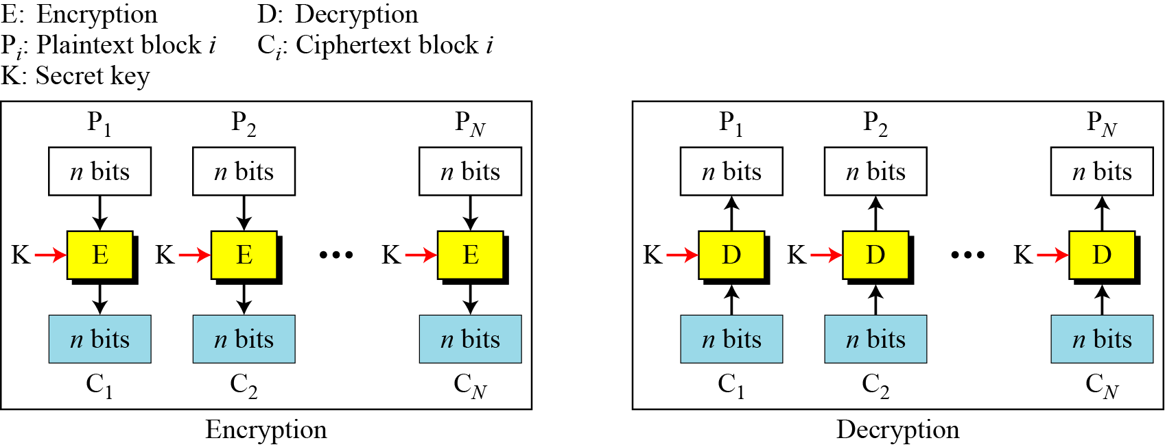
ECB Scheme
Notes:
Stallings Fig 3-11.

Slide 29
ECB
Encryption normally works by taking a number of text blocks, and then applies a key to these to produce cipher blocks.
Typical block sizes are 128 or 256 bits.
Unfortunately, the cipher blocks could end up being the same, for the same input text.
Thus an intruder could try and guess the cipher text. This is known as electronic code book.
For example if we use 3DES to encrypt the word “red”, with a key of “bert12345”, we will always get:
HgvGuzedMg8=
You will find that ever time you encrypt, you will get the same value.
Thus the intruder could start to guess what your mapping of the plain text to cipher text was.

Slide 30
Strength:
It’s simple.
Faster due to parallel Encryption .
Weakness:
Repetitive information contained in the plaintext may show in the cipher text, if aligned with blocks. If the same message is encrypted (with the same key) and sent twice, their cipher text are the same.
So it is not used for lengthy messages.

Slide 31
Cipher Block Chaining
To overcome the problems of repetitions and order independence in ECB, we want some way of making the ciphertext dependent on all blocks before it.
This is what CBC gives us, by combining the previous ciphertext block with the current message block before encrypting.
CBC mode is a method of encrypting data that ensures each block of plaintext is combined with the previous ciphertext block before being encrypted.
The symmetric key algorithm creates a ciphertext that depends on all plaintext blocks processed before it in a data stream. This is done to ensure that each block of the ciphertext is dependent on all of the previous blocks.
Each plaintext block is XORed (exclusive OR) with the previous ciphertext block before being encrypted with the cipher algorithm.
CBC mode is used in a variety of security applications. For example, Secure Sockets Layer/Transport Layer Security uses CBC mode to encrypt data that is transferred over the internet.

Slide 32
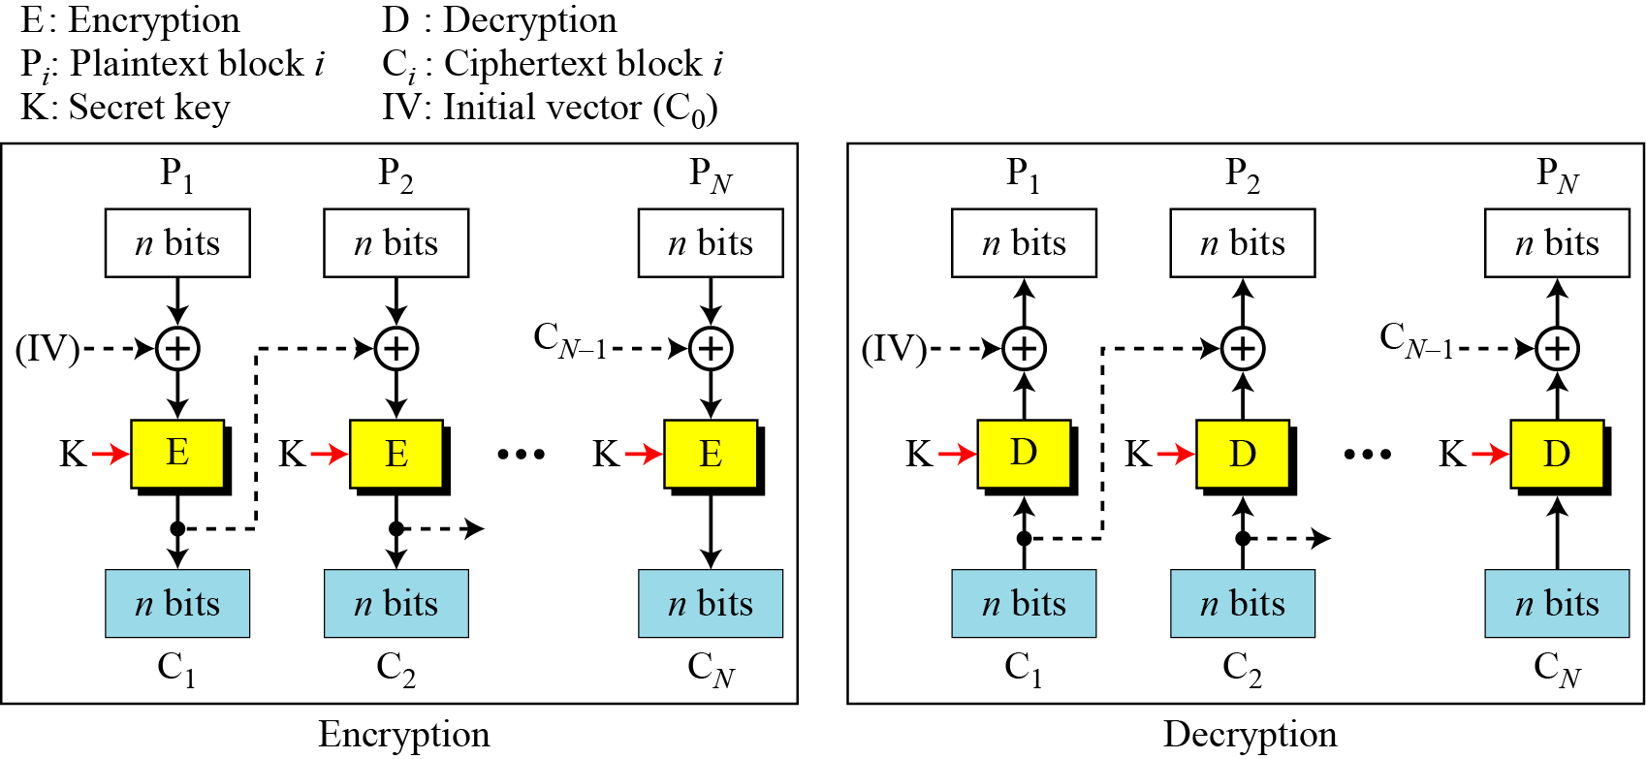
CBC scheme
Notes:
Stallings Fig 3-12.

Slide 33
Disadvantage
Parallel encryption is not possible.

Slide 34
Initialization Vector(IV)
An initialization vector is a random number used in combination with a secret key as a means to encrypt data. This number is sometimes referred to as a nonce, or “number occurring once,” as an encryption program uses it only once per session.
An initialization vector is used to avoid repetition during the data encryption process, making it impossible for hackers who use dictionary attack to decrypt the exchanged encrypted message by discovering a pattern.
The IV is the data block that is that same size as the cipher block.
The IV is known to both sender and the receiver but be unpredictable by a third party.

Slide 35
CTR mode
Initially the counter value is some random value. The counter value must be incremented by 1 for each block.
If the PT block size is 64 bits, then the counter value size should also be 64 bits.
Hence if same plaintext is used, we get different cipher text.
Also the function is performed parallel for all the blocks(similar to ECB mode).

Slide 36
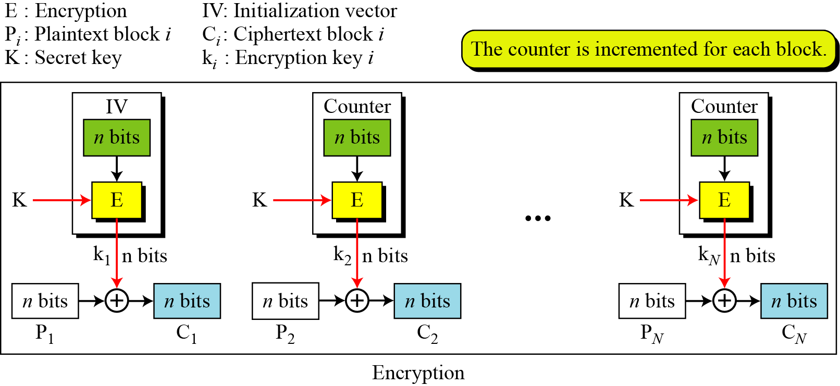
Counter (CTR) mode

Slide 37
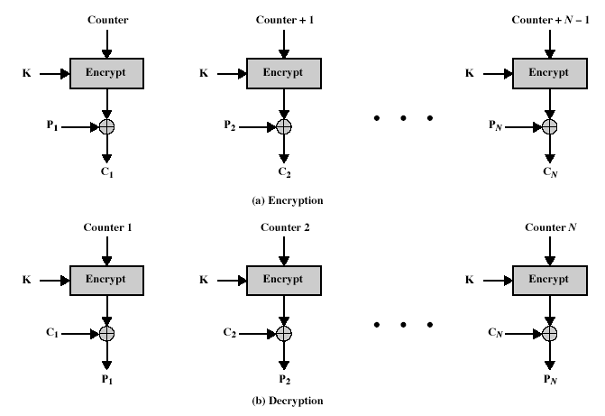
CTR Encryption and Decryption
Notes:
Stallings Fig 3-15.

Slide 38
Cipher Feed Back(CFB) Mode
The input to the encryption function is a b-bit shift register that is initially set to some initialization vector (IV).
The leftmost (most significant) s bits of the output of the encryption function are XORed with the first segment of plaintext P1 to produce the first unit of ciphertext C1, which is then transmitted.
In addition, the contents of the shift register are shifted left by s bits and C1 is placed in the rightmost (least significant) s bits of the shift register. This process continues until all plaintext units have been encrypted.

Slide 39
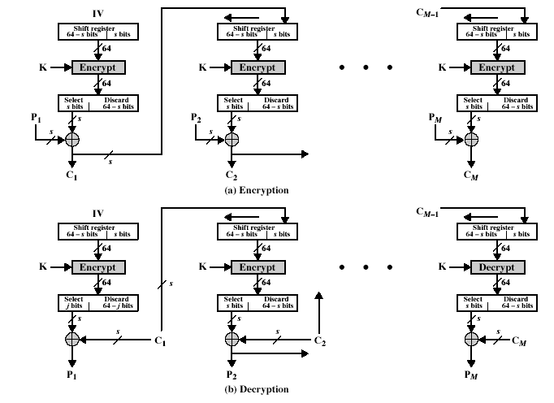
Notes:
Stallings Fig 3-13.

Slide 40
Output Feedback Mode(OFB)
Similar to CFB mode.
The output of the encryption function that is fed back to the shift register in OFB, whereas in CFB the ciphertext unit is fed back to the shift register.

Slide 41
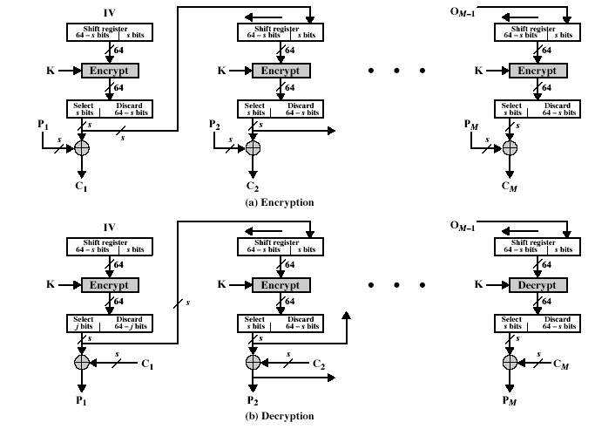
OFB
Notes:
Stallings Fig 3-14.

Slide 42
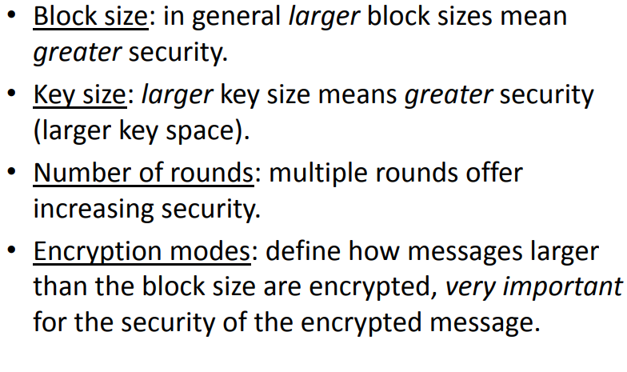
Block Cipher Features

Slide 43
Feistel Block Cipher
Feistel block cipher is a structure used to derive many symmetric block ciphers such as DES.
Feistel cipher proposed a structure which implements substitution and permutation alternately to obtain cipher text from the pain text and vice-versa.
In the Feistel block cipher, each block has to undergo many rounds where each round has the same function.
Feistel cipher proposed the structure that alternately implements substitution and permutation.
Substitution is implemented by replacing the elements of plain text or the set of elements of plain text by the element of cipher text or set of elements of cipher text.
A permutation is implemented by changing the order of elements of the plain text. No element here is replaced by any other element, only the order of elements is changed.

Slide 44
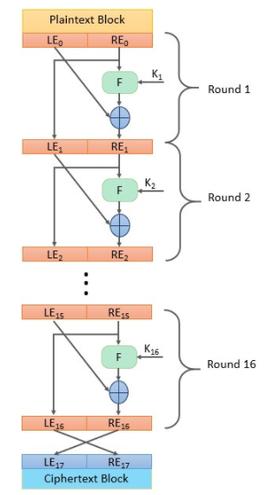
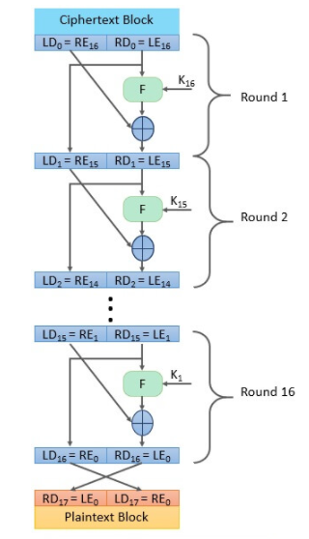
Feistel Cipher Structure

Slide 45
The Feistel Cipher
Feistel cipher algorithm
Create a list of all the Plain Text characters.
Convert the Plain Text to Ascii and then 8-bit binary format.
Divide the binary Plain Text string into two halves: left half (L1)and right half (R1)
Generate a random binary keys (K1 and K2) of length equal to the half the length of the Plain Text for the two rounds.
First Round of Encryption
Generate function f1 using R1 and K1 as follows:
f1= xor(R1, K1)
Now the new left half(L2) and right half(R2) after round 1 are as follows:
R2= xor(f1, L1)
L2=R1
Second Round of Encryption
Generate function f2 using R2 and K2 as follows:
f2= xor(R2, K2)
Now the new left half(L2) and right half(R2) after round 1 are as follows:
R3= xor(f2, L2)
L3=R2
Concatenation of R3 to L3 is the Cipher Text
Same algorithm is used for decryption to retrieve the Plain Text from the Cipher Text.

Slide 46
Feistel cipher was based on the structure proposed by Shannon.
Shannon structure has an alternate implementation of diffusion and confusion to obtain cipher text block.
Feistel cipher structure has alternate application substitution and permutation on plain text block to obtain cipher text block.
Feistel block cipher operates on each block independently.
The encryption and decryption algorithm in Feistel cipher is the same.
The key used for encryption and decryption is the same but the sequence of application of subkey is reversed.
During encryption a plain text block undergoes multiple rounds. But the function performed in each round is same.
Generally, 16 rounds are performed in Feistel cipher.
Typical block size of Feistel cipher is 64-bit but modern block cipher uses 128-bit block.
Typical key size of Feistel cipher is 64-bit but modern block cipher has 128-bit key size.

Slide 47
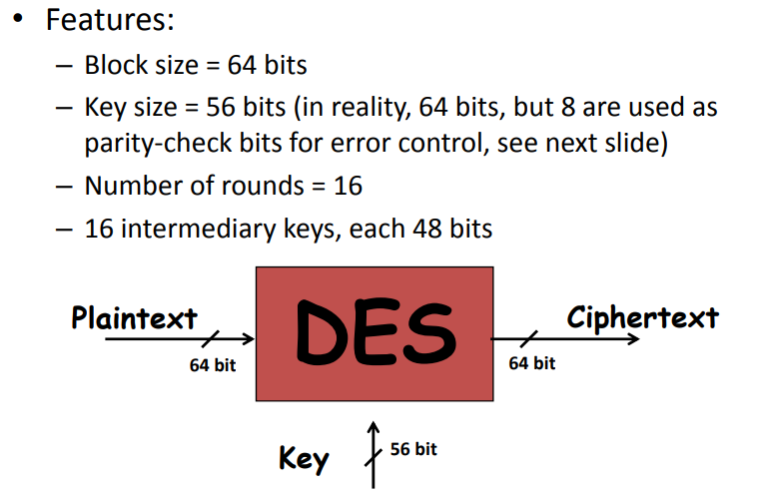
Data Encryption Standard

Slide 48
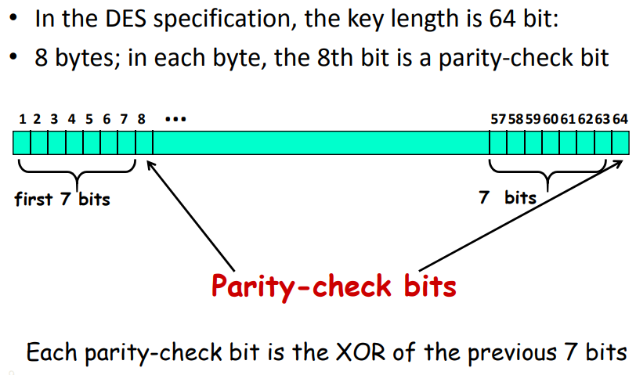
Key length in DES

Slide 49
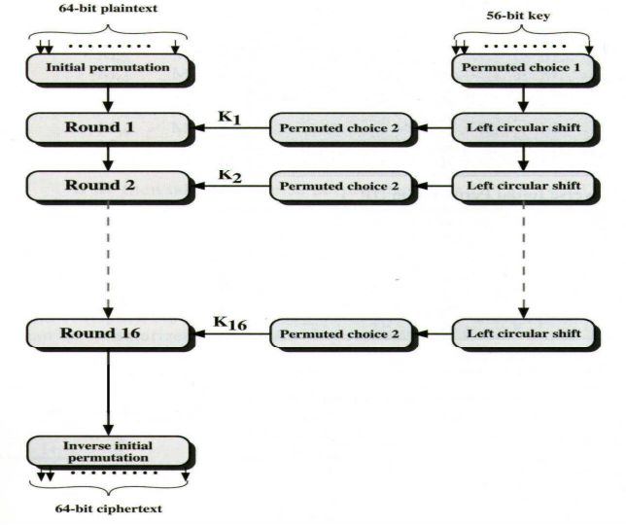
DES Encryption Algorithm

Slide 50
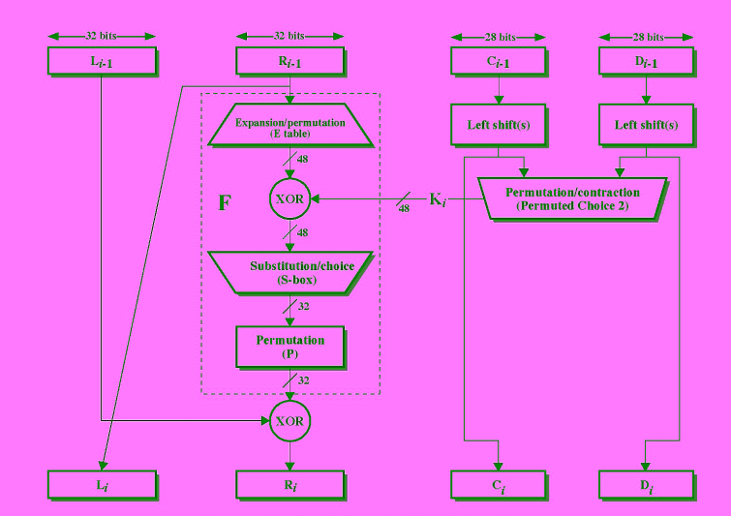
Singe Round DES

Slide 51
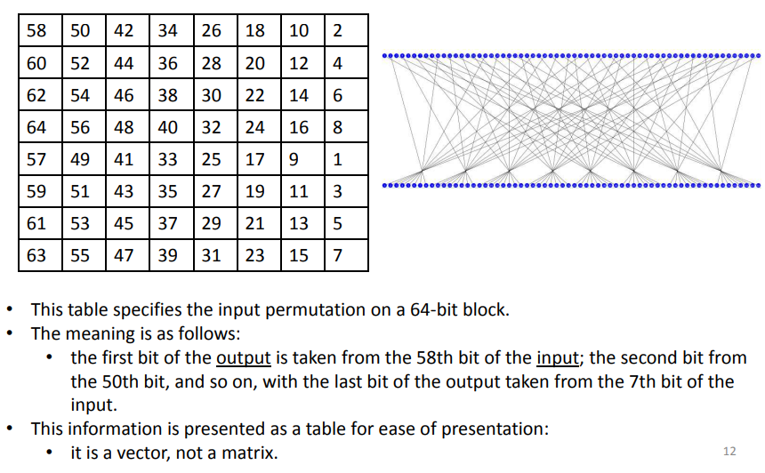
Initial Permutation(IP)

Slide 52
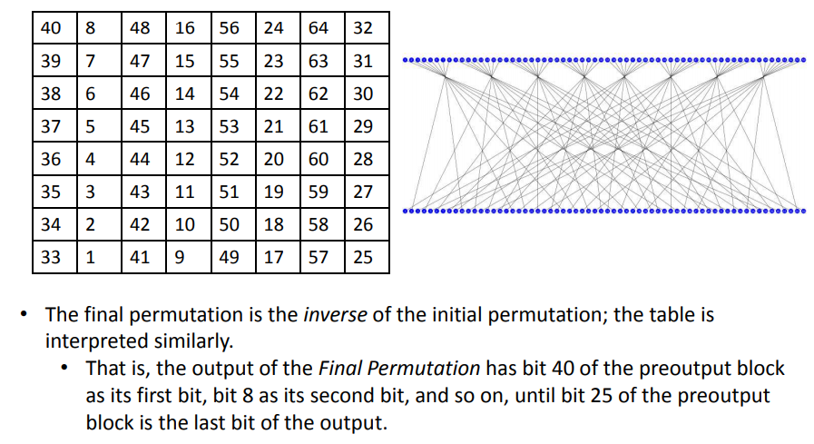
Final Permutation/Inverse IP

Slide 53
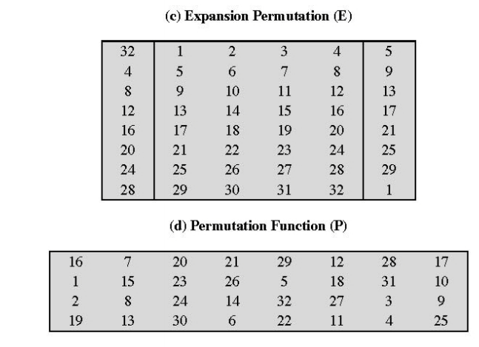

Slide 54
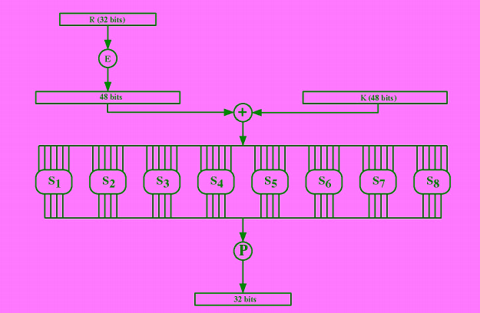

Slide 55
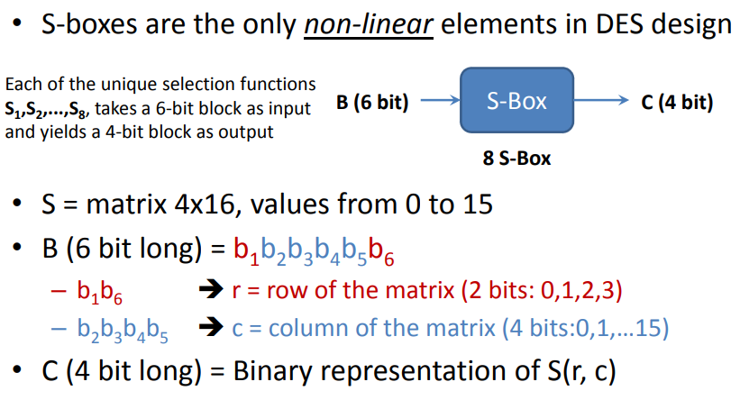
S-Box

Slide 56
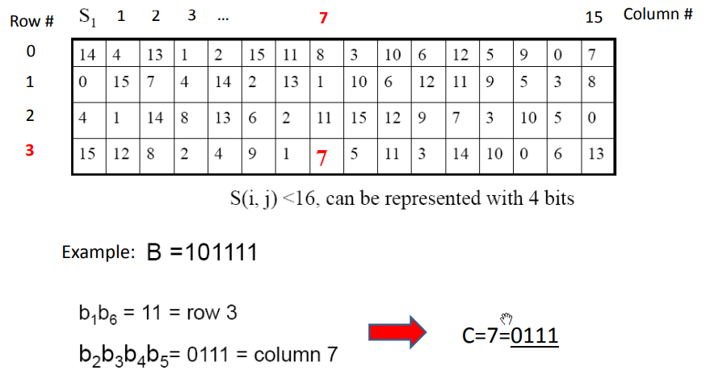

Slide 57
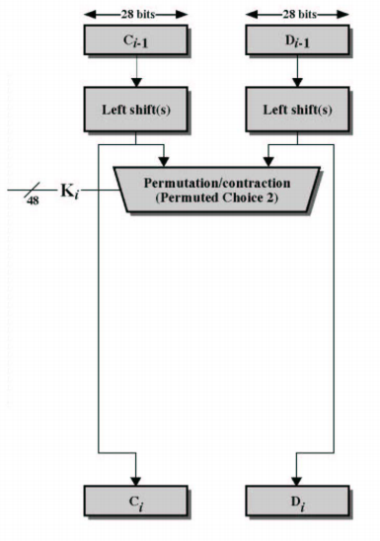
Sub Key Generation

Slide 58
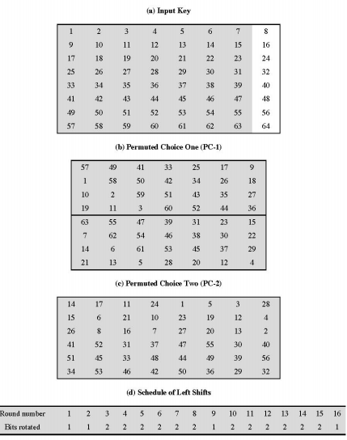

Slide 59
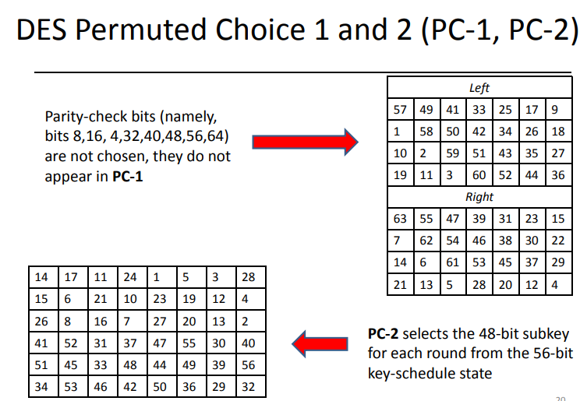

Slide 60
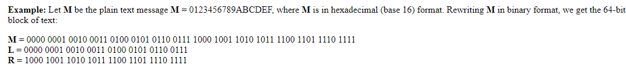
How DES works

Slide 61
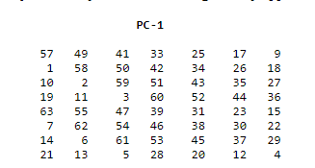
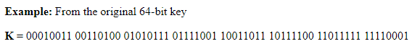
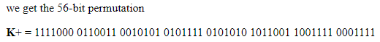
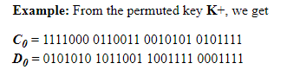
Step 1: Create 16 subkeys, each of which is 48-bits long.

Slide 62
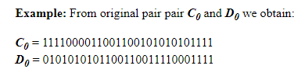
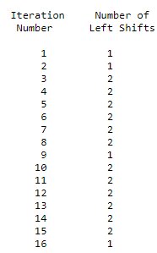
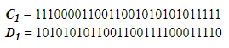
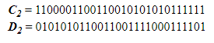

Slide 63
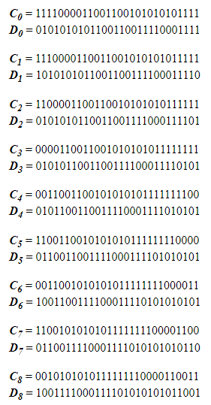
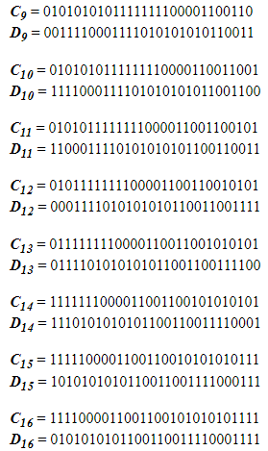

Slide 64
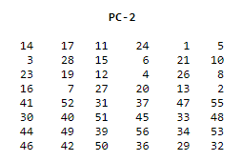
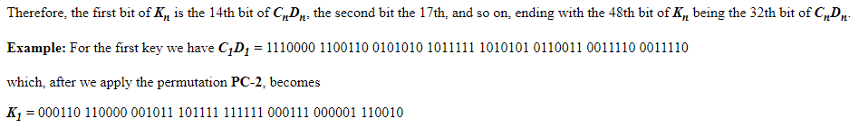
Calculate PC-2 (subkeys generated)

Slide 65


Slide 66
Step 2: Encode each 64-bit block of data.
There is an initial permutation IP of the 64 bits of the message data M.
This rearranges the bits according to the IP table, where the entries in the table show the new arrangement of the bits from their initial order.
The 58th bit of M becomes the first bit of IP. The 50th bit of M becomes the second bit of IP. The 7th bit of M is the last bit of IP.

Slide 67



Slide 68



Slide 69



Slide 70



Slide 71



Slide 72


Slide 73



Slide 74



Slide 75



Slide 76

Calculate

Slide 77


Slide 78


Slide 79



